Slide 1

The great Chinese firewall
Khalid Alghamdy
Yasser AlOmar
Meshari AlQahtani
Razan AlTamami

Slide 2
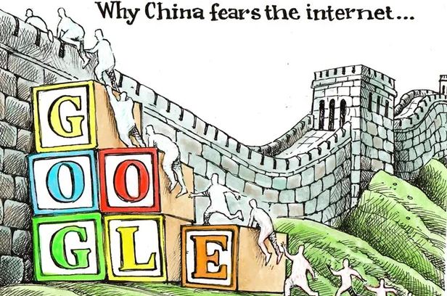


Goals:
Opposing the basic principles as they are confirmed in the Constitution.
Jeopardizing the security of the nation, divulging state secrets, subverting state power, or jeopardizing the integrity of the nation's unity
Harming the honor or the interests of the nation
Inciting hatred against peoples, racism against peoples, or disrupting the solidarity of peoples
Disrupting national policies on religion, propagating evil cults and feudal superstitions
Spreading rumors, disturbing social order or disrupting social stability
Spreading obscenity, pornography, gambling, violence, murder, terror, or abetting the commission of a crime
Insulting or defaming third parties, infringing on the legal rights and interests of third parties
Containing any other content prohibited by law or administrative rules

Slide 3

Timeline
Jan 1983
The internet is created
1994
The Internet makes its way to China
1998
Golden Shield Project begins taking form
1988 - 2006
2006 - 2008
Introduced IP Blocking and DNS Poisoning
TCP DROP and VPN crackdown
2006 – Present
Optimization and improvement of the wall and it’s subsidiary technologies

Slide 4
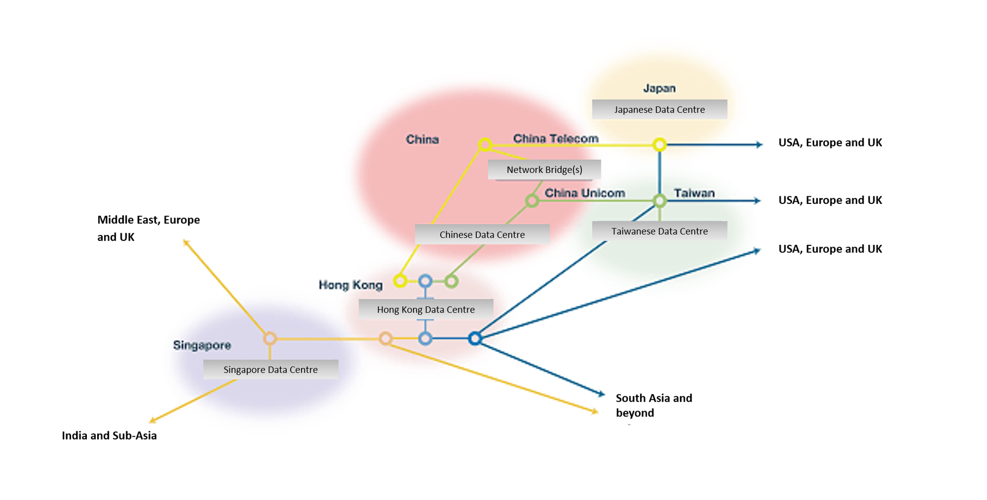
Topology
All data that flows into or out of China must go through one of the 14 Internet exchange points in China
All Internet exchange points are STATE owned
After that it gets routed to the appropriate ISP

Slide 5


Censorship methods
How does the firewall work?

Slide 6

IP BLOCKING

Slide 7
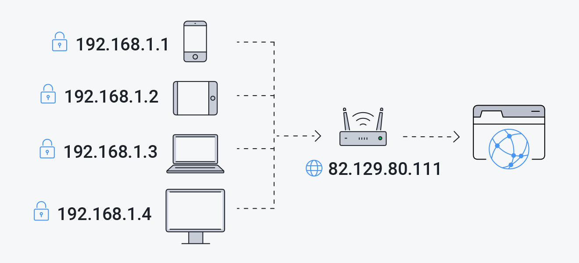
What is an ip address?
Each device that is connected to the Internet has a uniqueIP Address that can roughly map out where that device is connected from
That Ip address is assigned by your internet service
The public IP address is what is shared with the world not the private one.
Each device on a network has a private IP address, and the router has a public IP address to communicate with the rest of the internet.

Slide 8
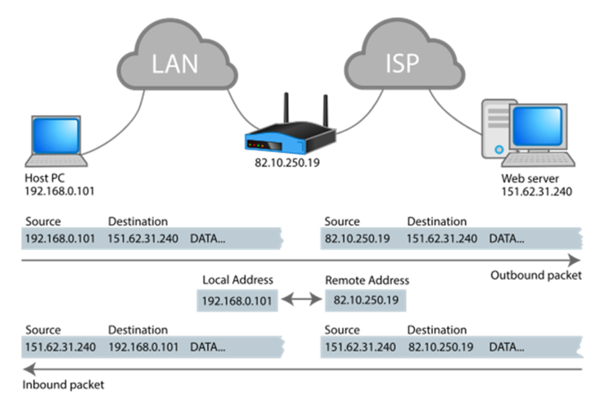
Network packet structure
An Internet packet consists of a header and a payload.
The payload is the actual data sent, the header however, is what we are interested in. It contains the source IP address and the destination IP address.

Slide 9
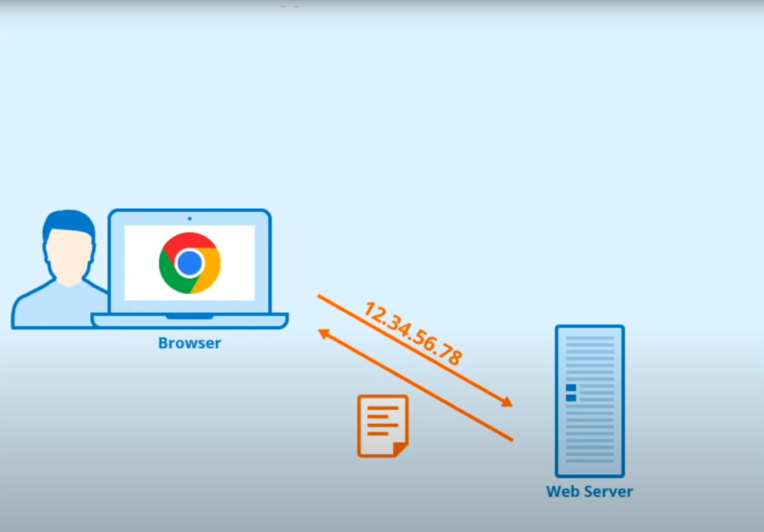
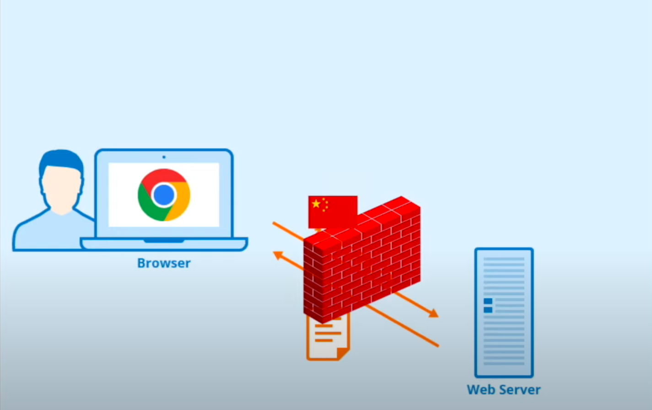
IP blocking procedure
China has a list of blocked IP addresses.
Internet packets contain source and destination addresses
All packets make their way to the ISP first
Internet packet is unpacked and destination address is crosschecked with the blocked IP list
If the destination address is in the blocklist it either reroutes to another address or sends that data to the void which ultimately leaves the sender in constant state of loading.

Slide 10

DNS POISONING

Slide 11
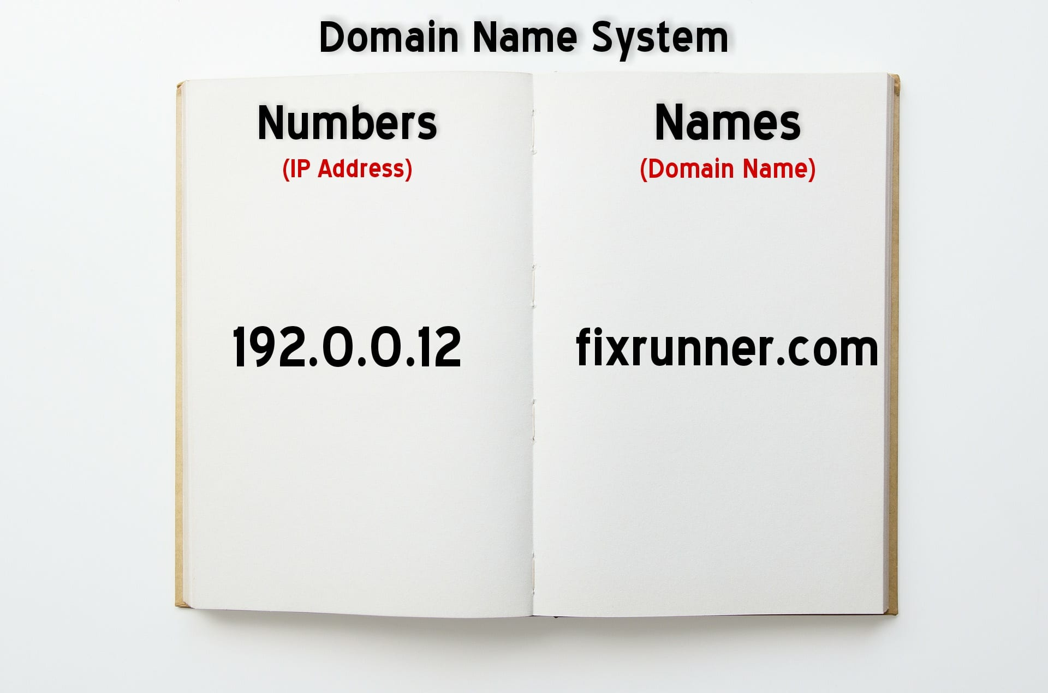
DNS (Domain Name system) can be thought of as the phonebook of the internet. It used to translate domain names to Ip addresses. Without DNS you’ll have to memorize the Ip address of every website you want to use.

Slide 12
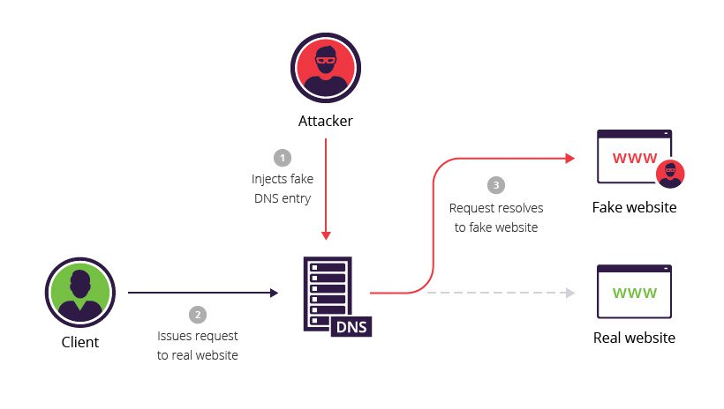
Procedure:
The user enters the domain name in the search bar.
The request is then sent to a DNS resolver which are servers in charge of tracking down the IP address that corresponds to that domain name
The requester then gets routed to that address.
The attacker in this case is China’s censorship
China has a DNS blocklist of over 15000 keywords

Slide 13

TCP DROP

Slide 14
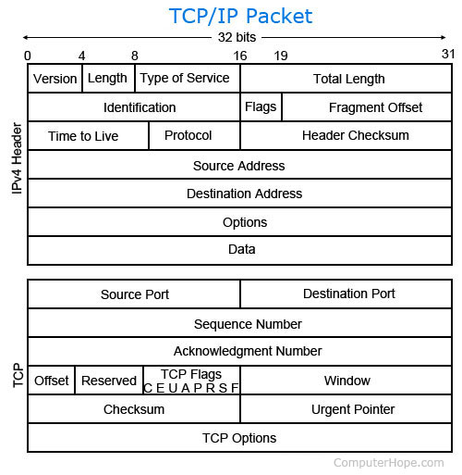
What is TCP?
TCP stands for Transfer control protocol. It’s an agreed upon set of “rules” that govern the transfer of internet packets.

Slide 15
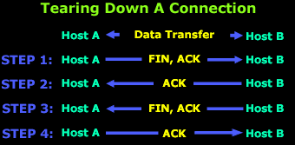
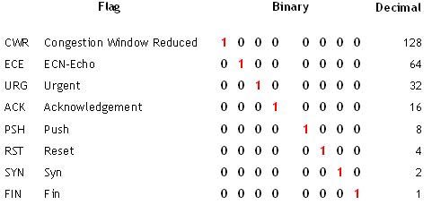
An example of tcp transfer
User finishes sending data: Sends final packet with FIN and ACK set to 1
Host B send a packet back with ACK set to 1
Host B then sends it’s own end of transmission packet with FIN and ACK set to 1
Host A send a packet back with ACK set to 1.
Transmission successfully finishes

Slide 16
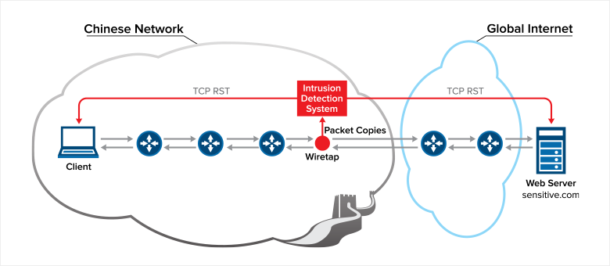
How does China abuse the TCP system?
Through the RST flag in the TCP protocol.
Remember all connection eventually lead to one of 14 internet exchange points.
.
1 – A person in China enters a website that contains blocked keywords.
2 – On a hardware level an internet packet is sent requesting access.
3 – That packet will propagate throughout the network on it’s way to its destination
4 - subsidiary machines set up by ISP’s will intercept that packet and start scanning the website for blocked keywords
5 – If it detects any blocked keywords and since it’s on the same network it will send a series of packets both ways with the RST flag set to 1.
6 – Both side interpret it as a genuine packet from the other end requesting to kill the connection and thus stops transmitting.

Slide 17
Quarterly performance

Slide 18


Areas of growth
 | B2B | Supply chain | ROI | E-commerce
Q1 | 4.5 | 2.3 | 1.7 | 5.0
Q2 | 3.2 | 5.1 | 4.4 | 3.0
Q3 | 2.1 | 1.7 | 2.5 | 2.8
Q4 | 4.5 | 2.2 | 1.7 | 7.0

Slide 19
IP BLOCKING

Slide 20




Meet the team
Takuma Hayashi​
Mirjam Nilsson​
Flora Berggren​
Rajesh Santoshi​
President
Chief Executive Officer
Chief Operations Officer
VP Marketing

Slide 21








Meet the team
Takuma Hayashi
Mirjam Nilsson​
Flora Berggren​
Rajesh Santoshi​
President
Chief Executive Officer
Chief Operations Officer
VP Marketing
Graham Barnes
Rowan Murphy
Elizabeth Moore
Robin Kline
VP Product
SEO Strategist
Product Designer
Content Developer

Slide 22
Plan for product launch
1
Planning
4
Strategy
Synergize scalable e-commerce
Foster holistically superior methodologies
2
Marketing
5
Design
Disseminate standardized metrics
Coordinate e-business applications
3
Launch
Deploy strategic networks with compelling e-business needs

Slide 23
Timeline
Sep 20XX
Synergize scalable
e-commerce
Nov 20XX
Disseminate standardized metrics
Jan 20XX
Coordinate e-business applications
Mar 20XX
May 20XX
Foster holistically superior methodologies
Deploy strategic networks with compelling
e-business needs

Slide 24
Areas of focus
B2B market scenarios​
Cloud-based opportunities​
Develop winning strategies to keep ahead of the competition​
Capitalize on low hanging fruit to identify a ballpark value​
Visualize customer directed convergence​
Iterative approaches to corporate strategy​
Establish a management framework from the inside​

Slide 25
How we get there
ROI
Niche markets​
Supply Chains
Envision multimedia-based expertise and cross-media growth strategies​
Visualize quality intellectual capital​
Engage worldwide methodologies with web-enabled technologies​
Pursue scalable customer service through sustainable strategies​
Engage top-line web services with cutting-edge deliverables​
Cultivate one-to-one customer service with robust ideas​
Maximize timely deliverables for real-time schemas​

Slide 26


Summary
At Contoso, we believe in giving 110%. By using our next-generation data architecture, we help organizations virtually manage agile workflows. We thrive because of our market knowledge and great team behind our product. As our CEO says, "Efficiencies will come from proactively transforming how we do business."​

Slide 27

Thank you
Mirjam Nilsson​​
mirjam@contoso.com​
www.contoso.com​

